Slide 1

The High Costs of Living and the Problems that Follow.
Darick cochrane

Slide 2
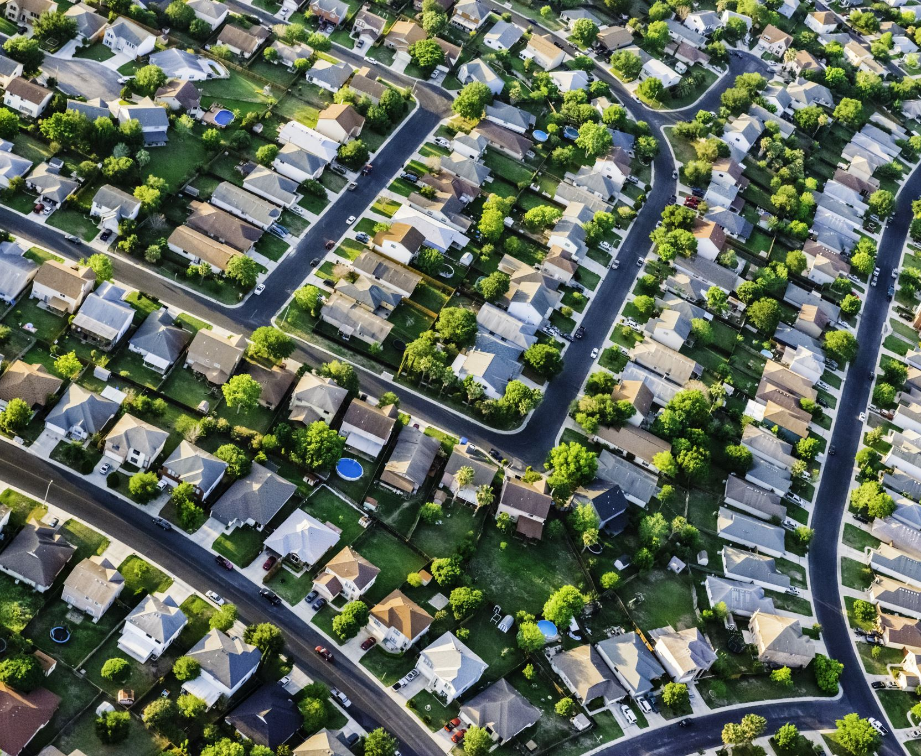
Did You Know…
Rent is at an all time high.
Housing costs are skyrocketing.
More kids are moving back in with their families.

Slide 3


Why it’s Important to me.

Slide 4
Research Questions
Cost of Living
Housing Costs
Earned Wages
Covid
How will Future Generations be Affected
Schooling

Slide 5

Current Knowledge

Slide 6
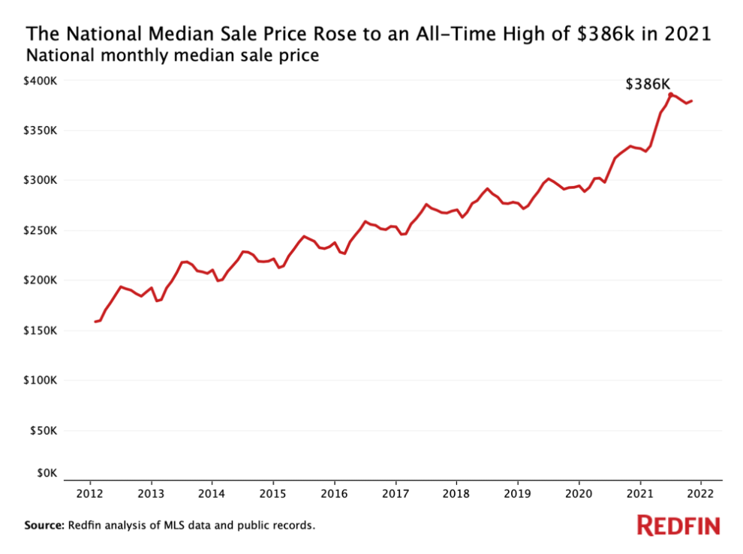


Slide 7
10 Years
2011-2012
In 2012, iPhone 5 was released.
Average rent in 2011 was $845.
2021
. Average rent in 2021 was $1,164
37% increase over 10 years – Follows inflation.

Slide 8
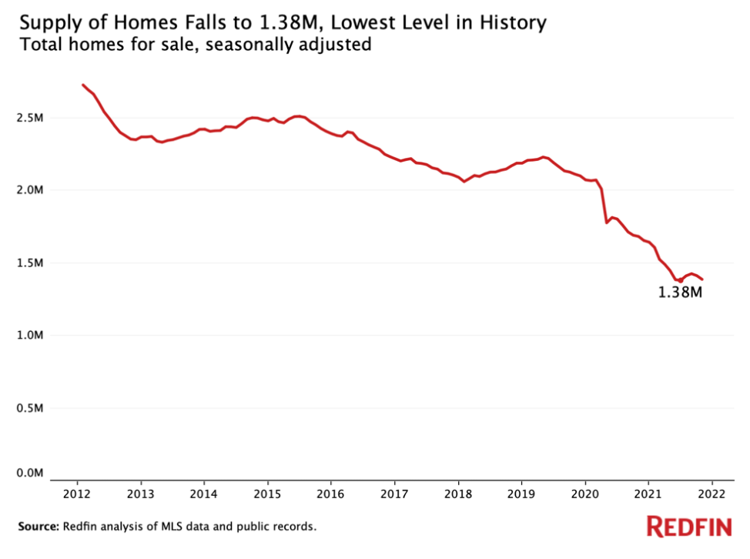


Slide 9
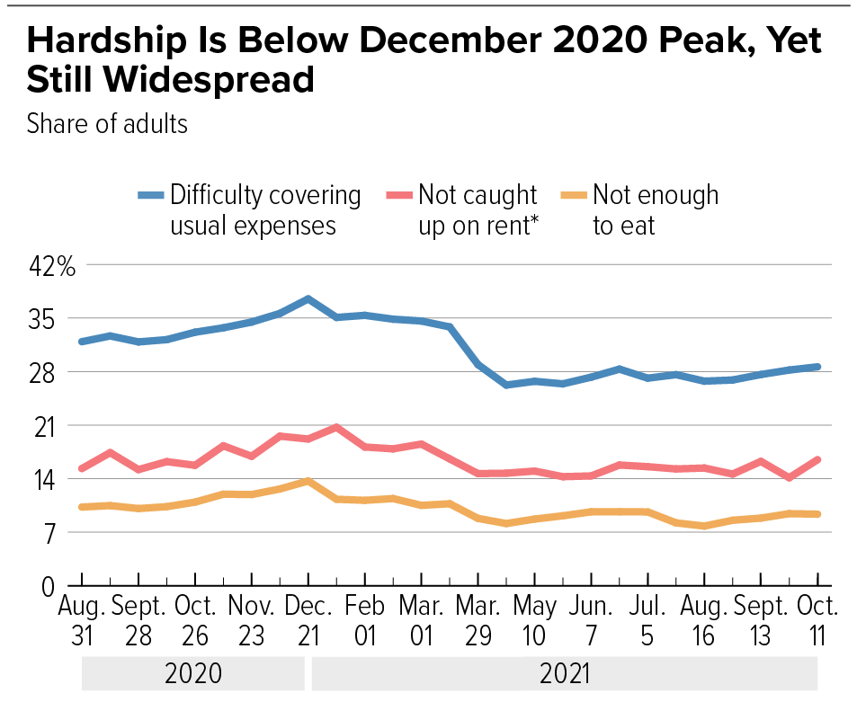
Source : CBPP analysis of Census Bureau Household Pulse Survey tables

Slide 10
INFLATION

Slide 11
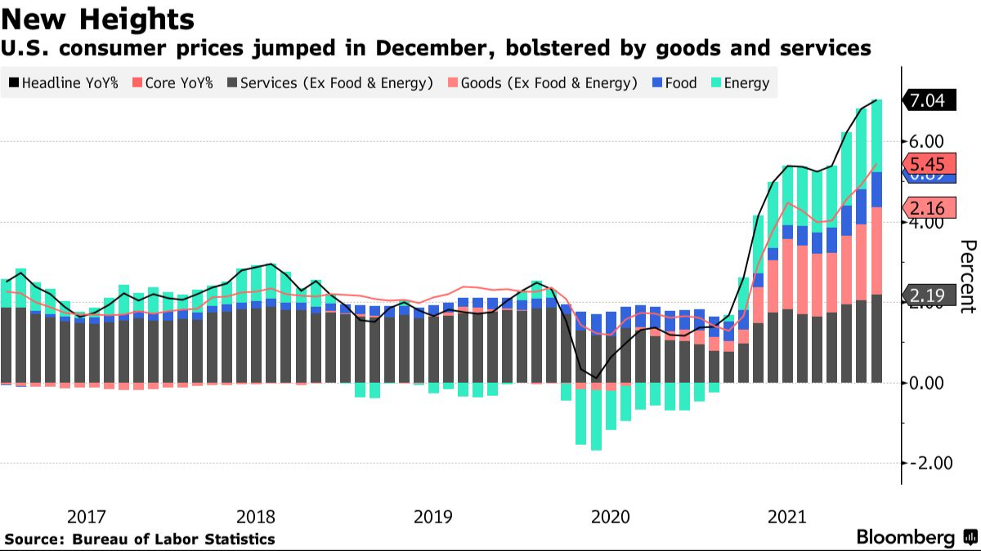

Slide 12
I DON’T KNOW

Slide 13

Unknowns
What is causing the rise in housing and rent.
How will this affect the economy.
How will marriages be affected.
How will this affect birthrates.

Slide 14
How I will find my answers
Primary : Interviews with colleagues and friends that have been impacted by the housing problems. Potentially have interviews set up with a real estate agent and professors.
Secondary : Articles and journals showcasing statistics about pre-covid to present time. Podcasts and economists.

Slide 15

So What?

Slide 16
Schedule
15 Feb.
A1 Slideshow Project Proposal
1 Mar.
A2 Annotated Bibliography
21 Mar.
A3 Think Piece
25 Apr.
A4 Research Paper
28 Apr.
Submit Final Portfolio

Slide 17
Sources
Parrott, Sharon, et al. “Tracking the COVID-19 Economy's Effects on Food, Housing, and Employment Hardships.” Center on Budget and Policy Priorities, Center on Budget and Policy Priorities, 10 Nov. 2021, https://www.cbpp.org/research/poverty-and-inequality/tracking-the-covid-19-economys-effects-on-food-housing-and#:~:text=The%20majority%20of%20jobs%20lost,of%20Labor%20Department%20employment%20data (Links to an external site.). Accessed 28 Jan. 2022.
https://www.istockphoto.com/photo/house-and-money-gm185121887-19551430
https://www.vectorstock.com/royalty-free-vector/not-for-sale-rubber-stamp-vector-12439987
https://www.redfin.com/news/housing-market-records-2021/
https://www.bloomberg.com/news/articles/2022-01-12/inflation-in-u-s-registers-biggest-annual-gain-since-1982

